Slide 1

ILLUSION MEDIA ADVERTISING AGENCY
PRESENTS
INTERNATIONAL SCHOOLS GO TALENTS
Your talent is God's gift to you. What you do with it is your gift back to God.
www.schoolsgottalents.com

Slide 2
EVERY CHILD IS A
Shinning STAR!
Let THEM Brightly shine!

Slide 3

Schools Football Cup & Talents Competition
REGISTER YOUR CHILD & YOUR SCHOOL TODAY
Brought to you by Illusion Media Advertising Agency

Slide 4
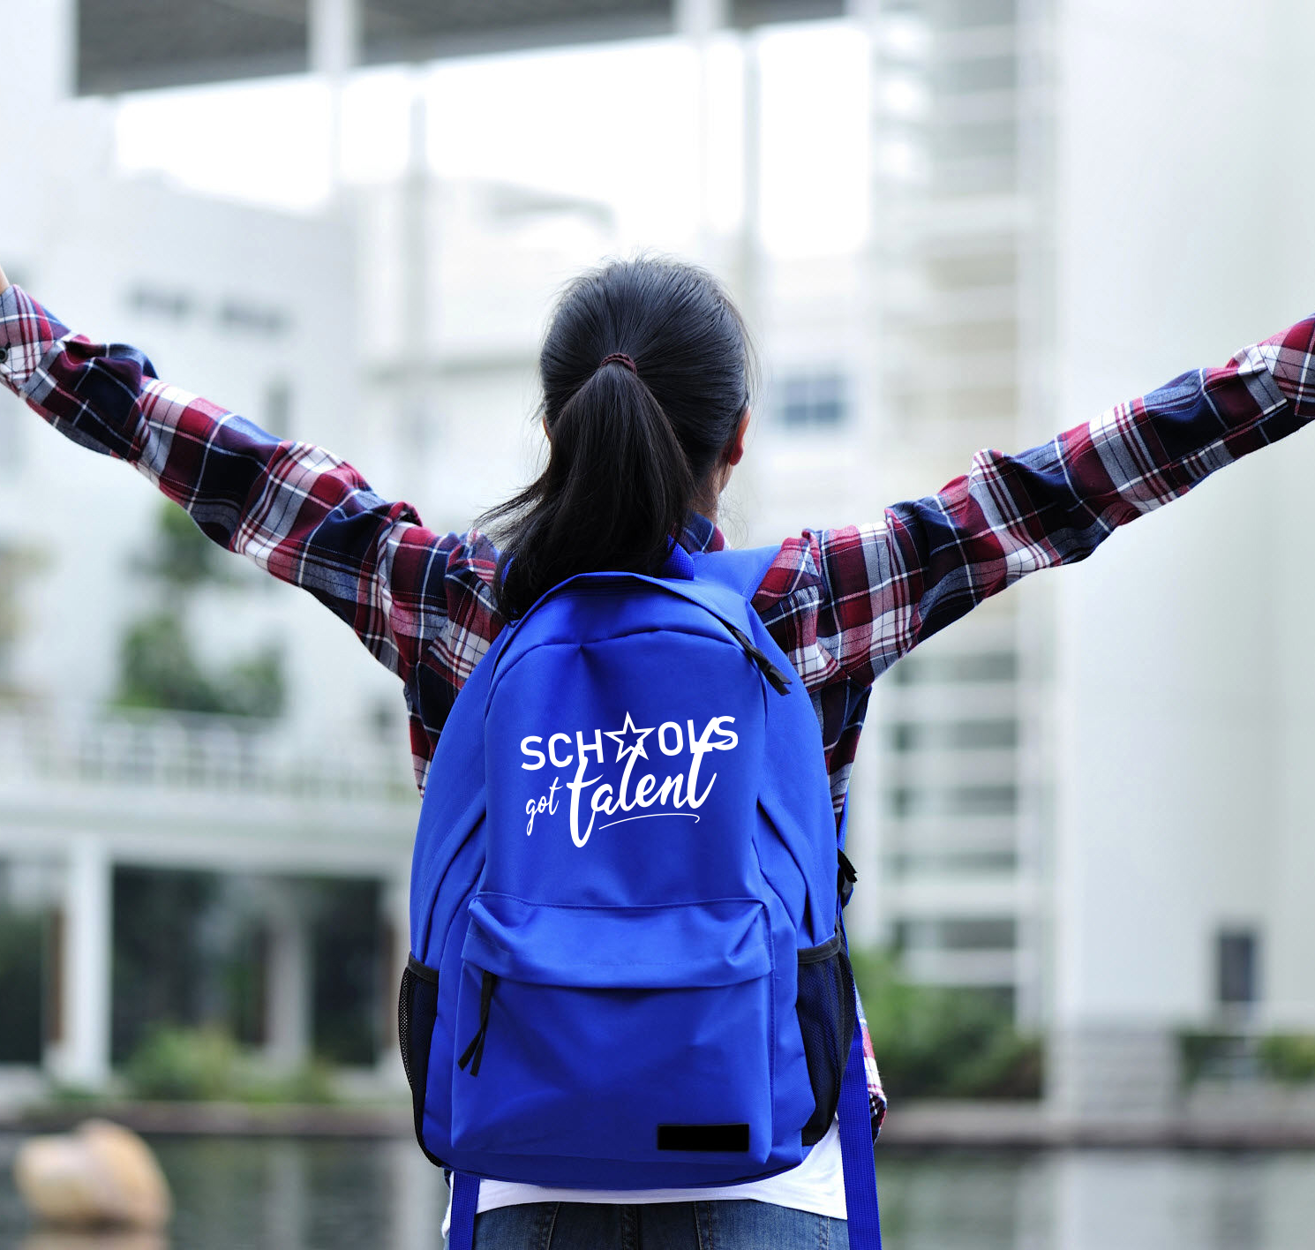
SPORTS & TALENT
COMPETITIONS
We have an important target … to give all the students an opportunity to explore themselves!
Help your student / child build their self confidence and get introduced to new community.
We are holding the most cheerful event … and event that holds fun and self exploartion to all the international schools students … elementary, middle, and high school!

Slide 5
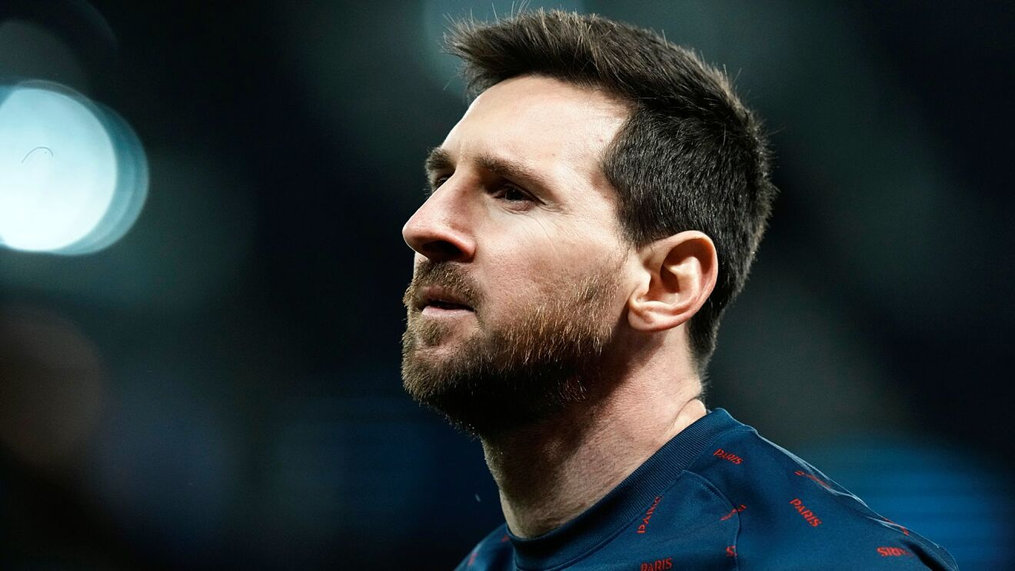
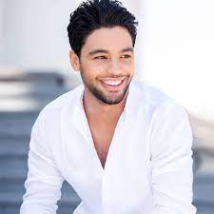
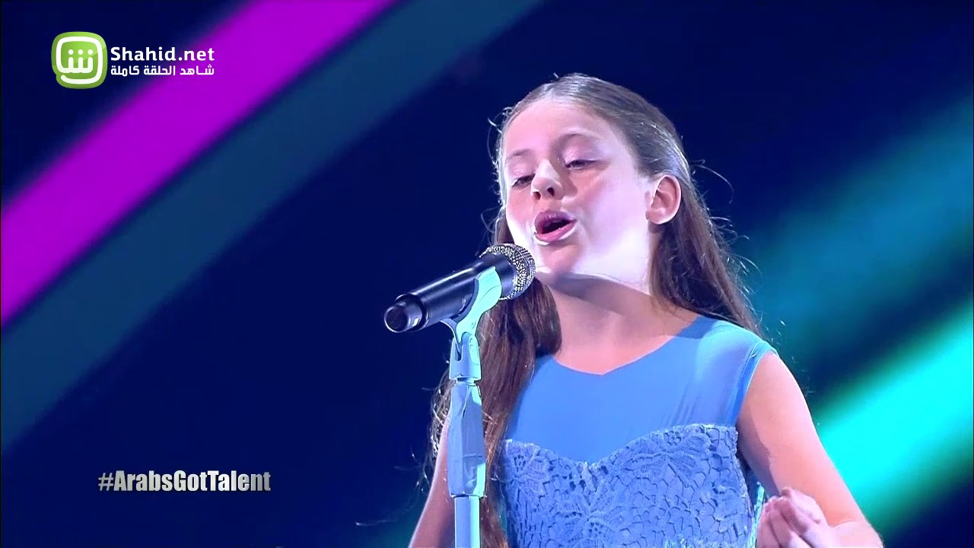
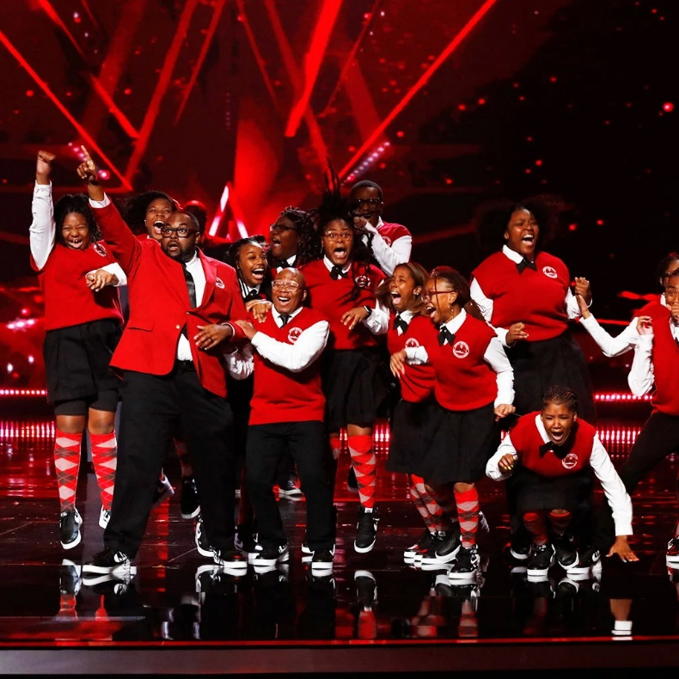
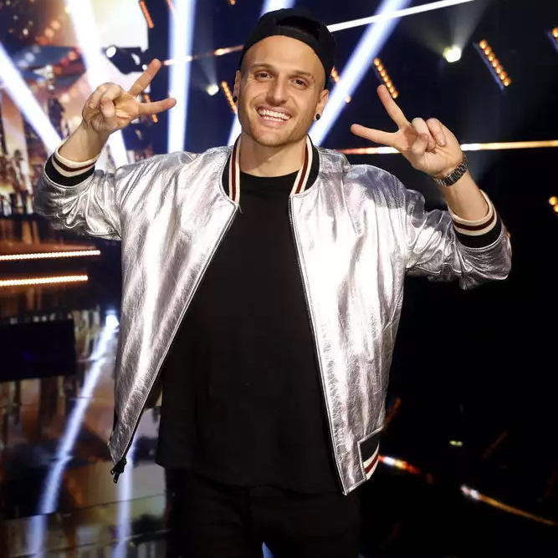
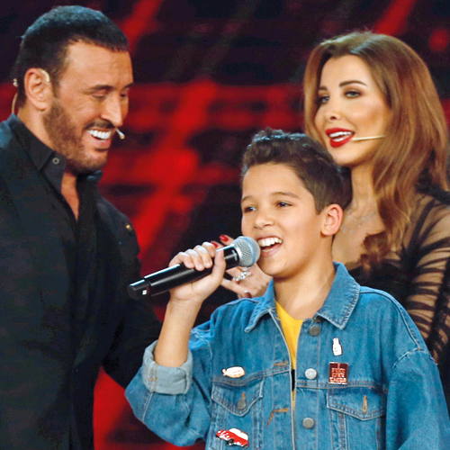
01
You Are
Worthwhile!
HARD
WORK
Your talent is worth the effort!
Pursing your abilities and working on them have never ever failed to pay off!
Self discovery In different aspects of life was never an easy task, yet it can be an important changing point in your life!
We will help you show off your talent in the different branches … singing, dancing, photography, and football!
Talent

Slide 6

SPORTS & TALENT
COMPETITION
The competition will be running for 2-3 months starting the applying process uptill the finals!
The final perfomance in each competition will be life on stage for the Vocal and dancing Friday 17th March 2023.
The football tournament finals will be played on one of the most important and highly esteemed football fields in Egypt!
WELCOME MESSAGE

Slide 7


1. MEET NEW PEOPLE
2. GET CREATIVE!
3. WIN PRIZES!
Meet 100s of other students from all
International schools all over Egypt!
Schools Got Talents is the best place to express your creativity! from singing to costumes, and stage rehearsals etc.
We want to see you get creative.
Win awesome prizes, trips, trophies, gift cards and MORE!
4. COMPETE!
5. BUILD SKILLS!
Compete with lots of International schools. Show off your skills and most of all be prepared to have the best time of your life!
Let “Schools Got Talents” be the start to build your leadership, teamwork,
creativity & communication skills!
6. LEARN & SHARE
CULTURE!
7 Reasons
Why YOU
Have To
Join us!
Through creativity learn more about the culture and how you can mix it with your own!
7. HAVE FUN!
Schools Got Talents is all about creating the perfect event for high school students to have fun! So get ready to dance, meet new people and win some amazing prizes!

Slide 8

6 COMPETITIONS
Your talent is God's gift to you. What you do with it is your gift back to God.

Slide 9




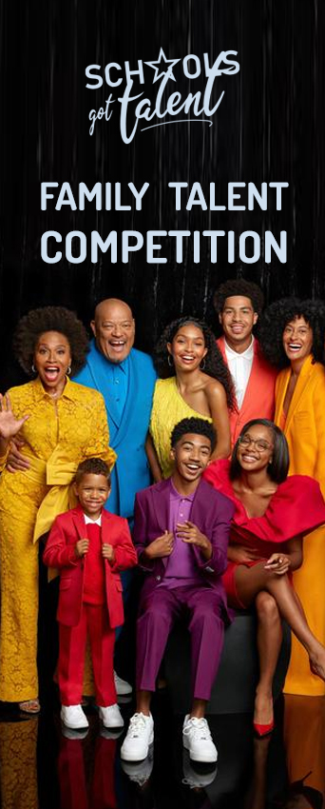

1
2
3
4
5
6
MARTA S,

Slide 10
Individual Registration in 3 COMPETITIONS
(VOCAL SOLO – FAMILY TALENT – PHOTOGRAPHY)
ONLINE REGISTRATION
on our website.
All Competitors should be registered in any International school In Egypt!
Schools only Registration Competition!
(FOOTBALL CUP– VOCAL GROUP – GROUP DANCE)
Registration Is open for International Schools only!

Slide 11


FOOTBALL
CUP
1
REQUIRES SCHOOL REGISTRATION

Slide 12
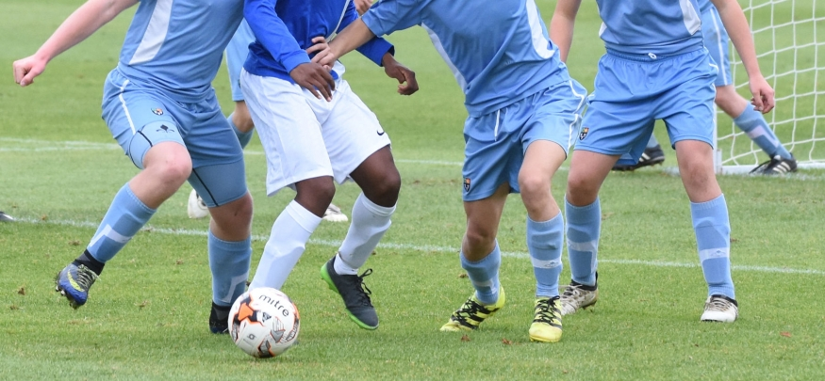

School representation in Schools Got Talent Competition offers children the opportunity to develop their abilities and demonstrate their talent.
Personal development of all children is vital as they grow and the positive values that children hold as they participate in schools' football, such as leadership, sportsmanship, integrity as well as their own character traits such as effort, determination and perseverance are key life skills that are developed through sport. These are the very skills that children will need for the future in a very demanding world.
FOOTBALL CUP

Slide 13
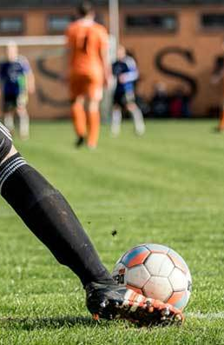

Season 2022-2023
Group Phase: This competition is based on the Champions League format. Teams will be drawn in groups of 4 - 6 teams with each team playing each other once before Christmas. In the group phase a win will gain 3 points a draw will gain 1 point and a defeat will gain 0 points. The winners and runners-up of the group phase will qualify to compete in the knockout phase.
Knockout Phase: The winners and runners-up of each group will progress to the knockout phase. At this point matches will take place on the cup-tie principle, using extra time and penalties if necessary to determine which team progresses to the next round.
This particular competition is our highest level of inter-school competition. It is open to all International schools with the maximum of 25 students per team selected by the schools according to our age verification policy!
All matches are played outdoor in a very well esteemed football field.
Age groups: Format
Under 15 (Middle School) 11 v 11
Under 18 (High School) 11 v 11
FOOTBALL CUP

Slide 14

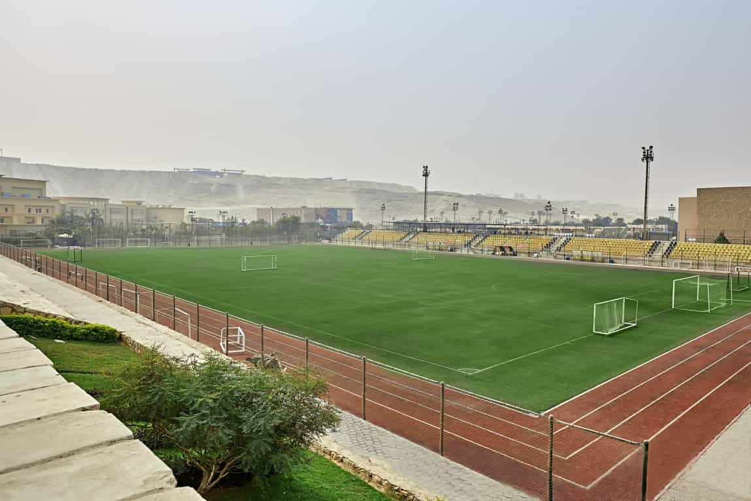
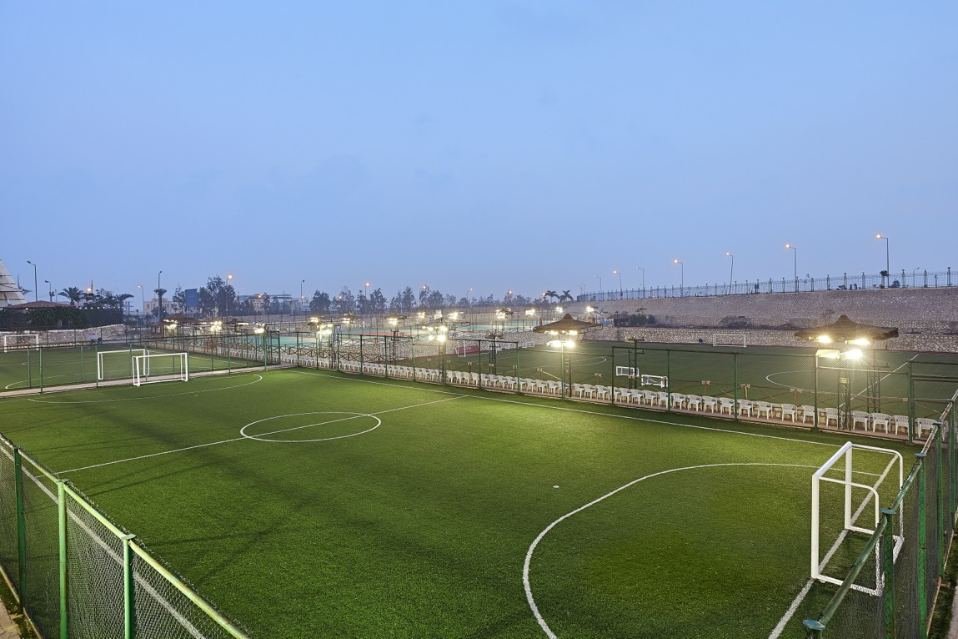

VENUE
All matches will be played in
WAGI DEGLA CLUBS
football fields.
Football talent scouts will be attending all the matches!
FOOTBALL CUP

Slide 15

VOCAL SOLO
COMPETITION
2
ONLINE REGISTRATION

Slide 16
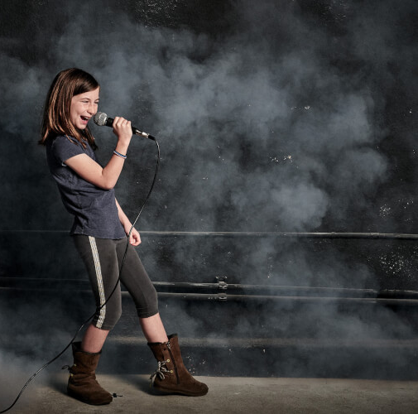


Music binds our soul, heart and emotions. Music is the best method of relaxation. It cheers the spirit and lightens the heart. In fact through singing children learn to express their feelings and ideas. To bring out the singing talent of the students VOCAL SOLO Competition is organized for Middle and High School Students.
JUNIOR, MIDDLE & HIGH SCHOOL STUDENTS

Slide 17
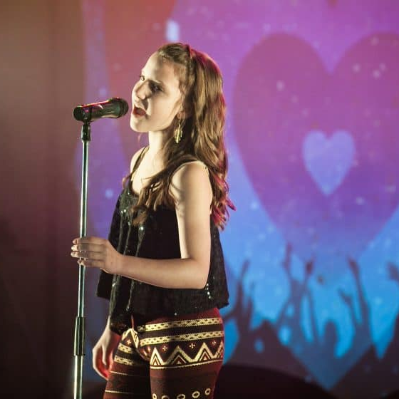

Rules and Regulations of Solo Singing Competition:
Entry is FREE with ONLINE REGISTRATION
Entry is open to all British International Schools from Middle and High School
Participants are free to sing an English or Arabic cover song of their choice.
All genres are welcome
The song chosen to perform must not contain any vulgarity or it shouldn't be in a manner that hurts the feelings of any religion or community. Violation of this results in a disqualified entry.
The song should be in raw audio format ( no studio recording).
RULES & REGULATIONS
VOCAL SOLO COMPETITION

Slide 18


1
VOCAL SOLO
The contest begins with a preliminary round, in which students sing pre-recorded song and uploaded whilst registration.
Competitors are responsible for their video including their music with submission. When submitting, please label your video file with your FULL name for clear identification, such as Name, school, competition : (Example: STUDENT NAME_SCHOOLNAME_SOLO2022).
Please submit your video in high-quality MP4 format for better results. We also encourage all competitors to submit videos that are filmed vertically (Portrait) NOT HORIZONTAL, if you are recording from your phone.
PERFORMANCE & COMPETITION
Contest qualifiers
2
Second round will be life performance on stage.
3
Finalist will be life performance on stage in front of parents and audience in a Big festival 17th MARCH 2023.

Slide 19

VOCAL GROUP
COMPETITION
3
REQUIRES SCHOOL REGISTRATION

Slide 20

“Words make you think.
Music makes you feel.
A song makes you feel a thought”

Slide 21
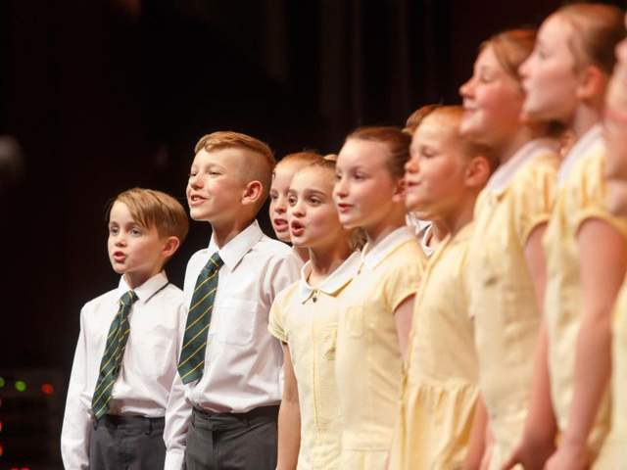

Entry is FREE For International Schools in Cairo (registration is required)
Entry is open to all International Schools in Cairo. from Junior, Middle and High School
Participants are free to sing an English or Arabic cover song of their choice.
All genres are welcome
All performances are limited between 2 minutes to 3 minutes. Any video or performance that exceeds 3 minutes will be manually faded out (a few seconds over 2 minutes is fine if you are transitioning out of frame/music)
The song chosen to perform must not contain any vulgarity or it shouldn't be in a manner that hurts the feelings of any religion or community. Violation of this results in a disqualified entry.
The song should be in raw audio format ( no studio recording).
The choice of the costume will be considered.
RULES & REGULATIONS
Middle and High School Students.
VOCAL GROUPCOMPETITION

Slide 22
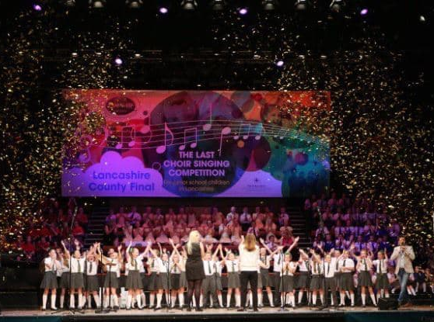
1
VOCAL GROUP
The contest begins with a preliminary round, in which students sing pre-recorded song and sent it Online.
Competitors are responsible for their video including their music with submission. When submitting, please label your video file with your FULL name for clear identification, such as Name, school, competition : (Example: STUDENT NAME_SCHOOLNAME_GROUP2023).
Please submit your video in high-quality MP4 format for better results. We also encourage all competitors to submit videos that are filmed vertically (Portrait) NOT HORIZONTAL, if you are recording from your phone.
PERFORMANCE & COMPETITION
Contest qualifiers
2
Second round will be life performance on stage.
3
Finalist will be life performance on stage in front of parents and audience in a festival 17th MARCH 2023.

Slide 23
DANCE GROUP
COMPETITION
4
REQUIRES SCHOOL REGISTRATION

Slide 24
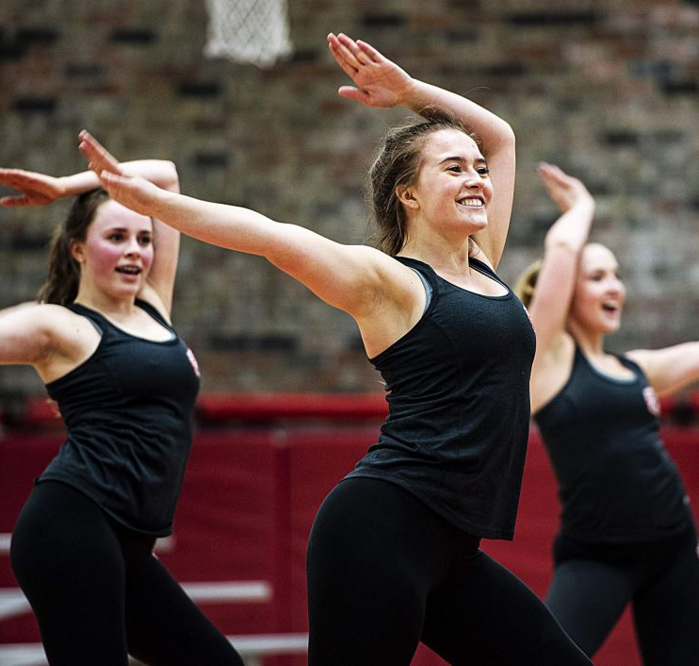
DANCING
COMPETITION
OH
HEY!
Freestyle dance competition with an aim to encourage students to participate in activities beyond learning. It is a platform to promote teamwork, boost confidence levels and inspire students to connect culturally through the art of dance.
JUNIOR, MIDDLE & HIGH SCHOOLS’ STUDENTS

Slide 25
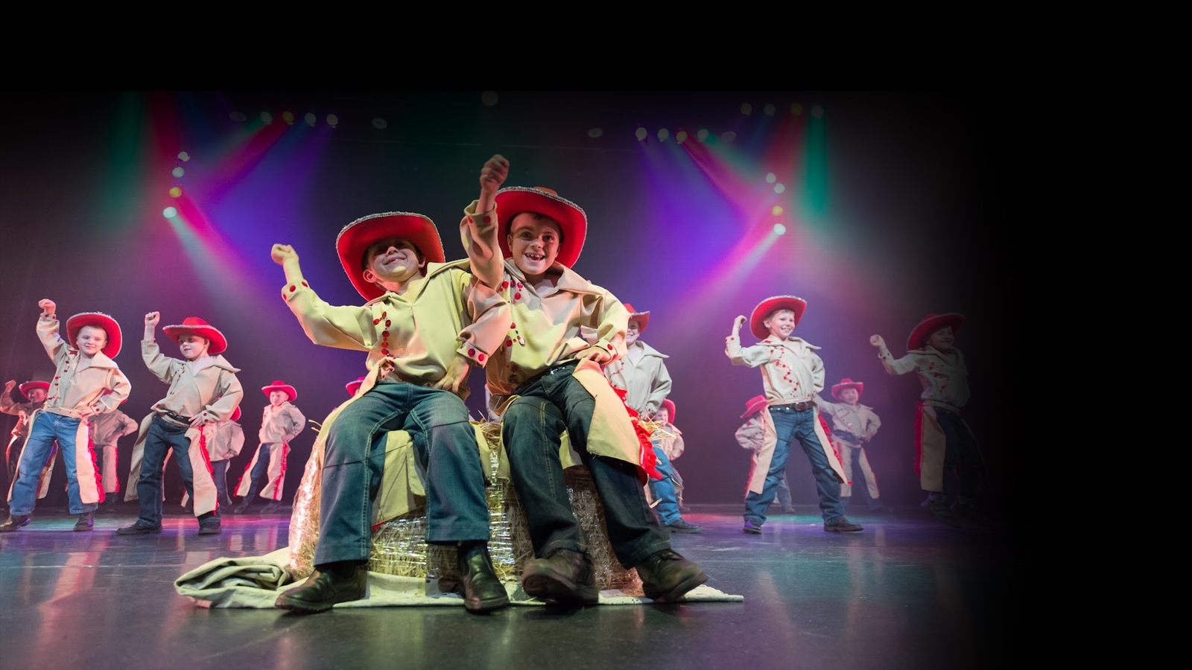
1
DANCE GROUP
The contest begins with a preliminary round, in which students make a pre-recorded dance and sent it Online.
Dance have to be a minimum of 3 minutes and maximum of 5 minutes. When submitting, please label your video file with your FULL name for clear identification, such as Name, school, competition : (Example: STUDENT NAME_SCHOOLNAME_DANCE2023).
Please submit your video in high-quality MP4 format for better results. We also encourage all competitors to submit videos that are filmed vertically (Portrait) NOT HORIZONTAL, if you are recording from your phone.
PERFORMANCE & COMPETITION
Contest qualifiers
From Second Round…
The choice of the costume will be considered.
2
Second round will be life performance on stage.
3
Finalist will be life performance on stage in front of parents and audience in a festival 17th MARCH 2023.

Slide 26
PHOTOGRAPHY
COMPETITION
5
If your child is constantly looking for the best angle, lighting and composition for his/her shots, you shouldn't let their talent be wasted!
ONLINE REGISTRATION

Slide 27

Photography is a great medium as you can approach it from many angles from the super-technical to the purely artistic, and it can inspire groups that struggle with other art forms. Most people have access to a phone with a camera, and that’s all you need to take part.
PROFESSIONAL CONTEST
MOBILE CONTEST

Slide 28

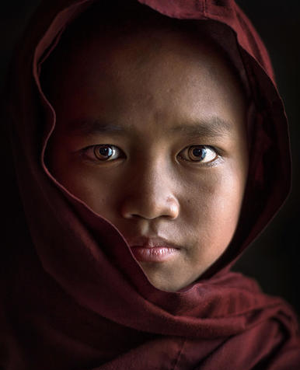
We hope the ‘A Day in Your Life’ photography competition can open up a world of different photographic ideas, on any subject or style. The 2019 winners had their work exhibited at the world-famous Saatchi Gallery, while others won Leica camera equipment, University of the Arts offer short university courses, bursaries, mentorships and memberships to respected photographic clubs.
What we're asking is for Young People to submit 5 photographs that tell the story of a day in their lives.
PHOTOGRAPHY
PROFESSIONAL CONTEST

Slide 29
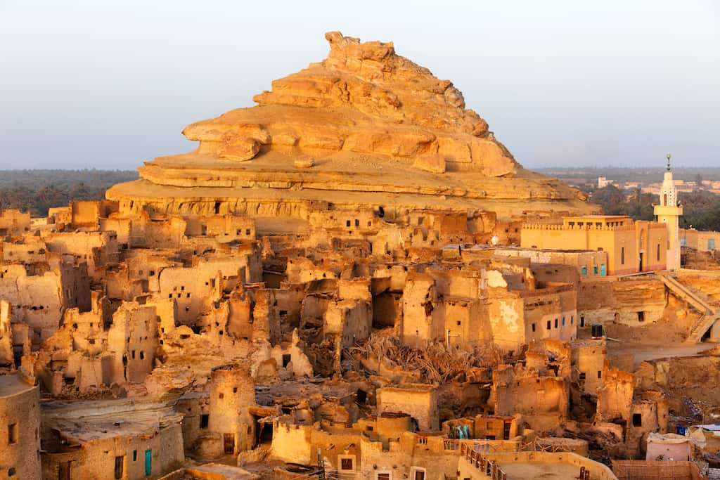
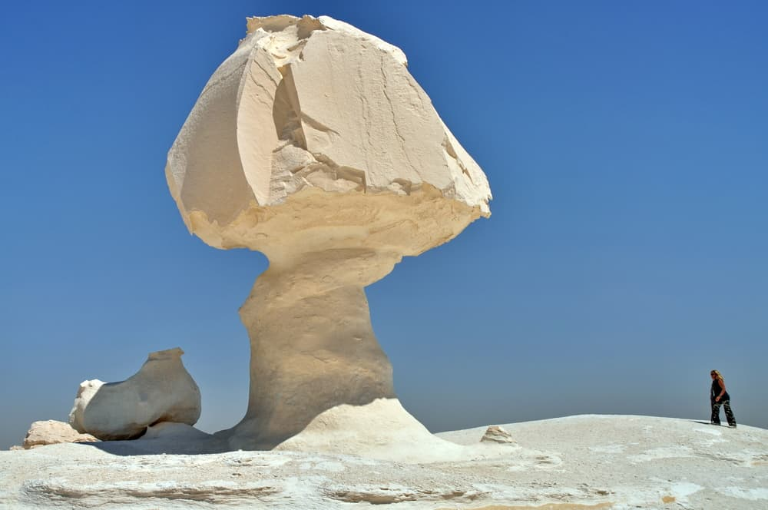

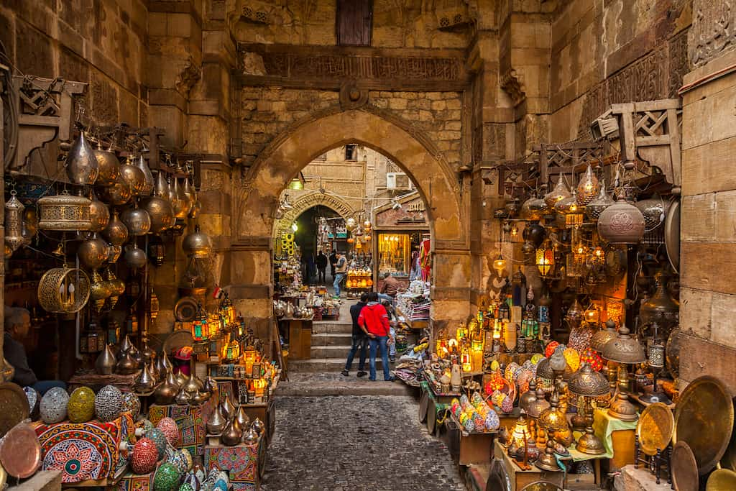
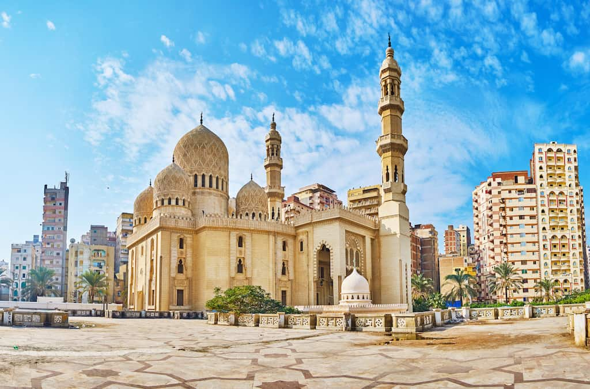
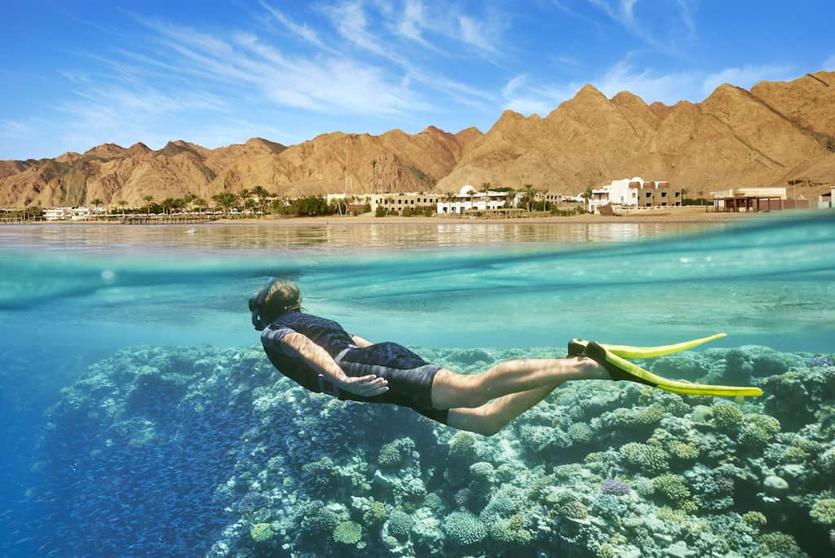
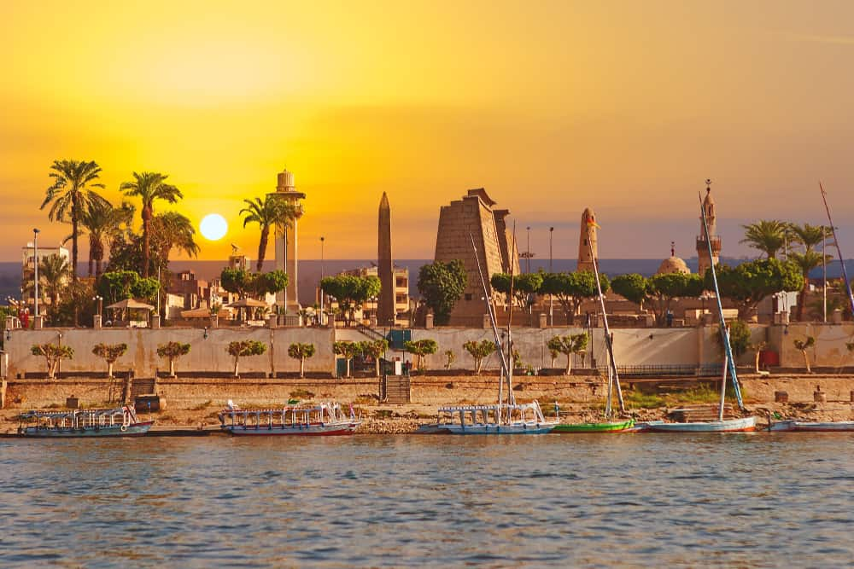
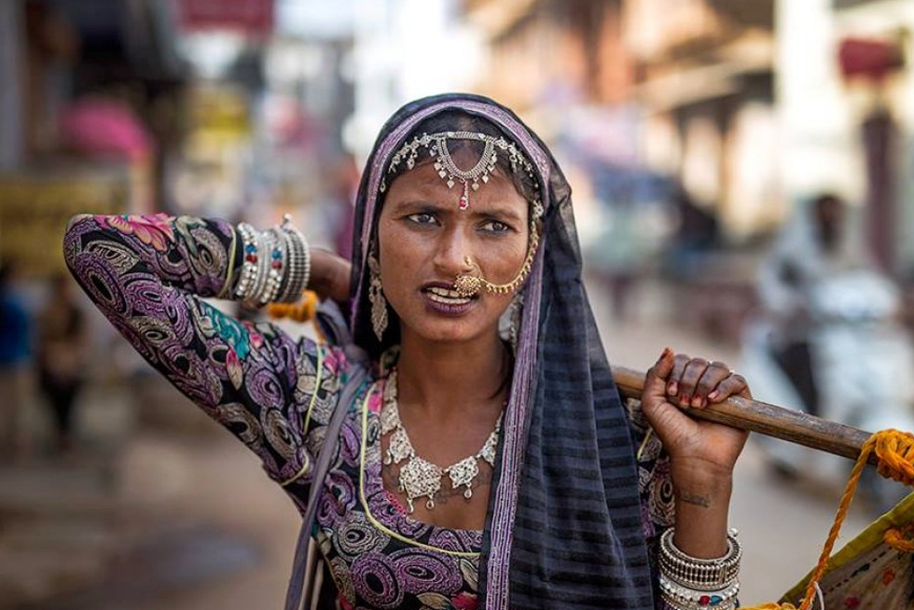
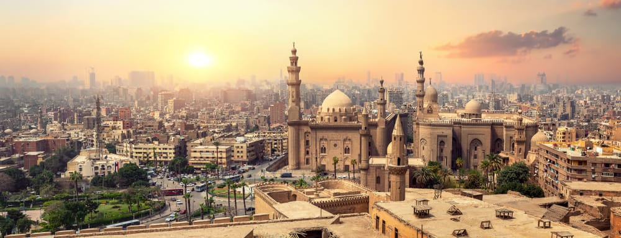
“THE BEAUTY OF EGYPT”
PROFESSIONAL CONTEST

Slide 30
THE BEAUTY OF EGYPT
PROFESSIONAL CONTEST

Slide 31
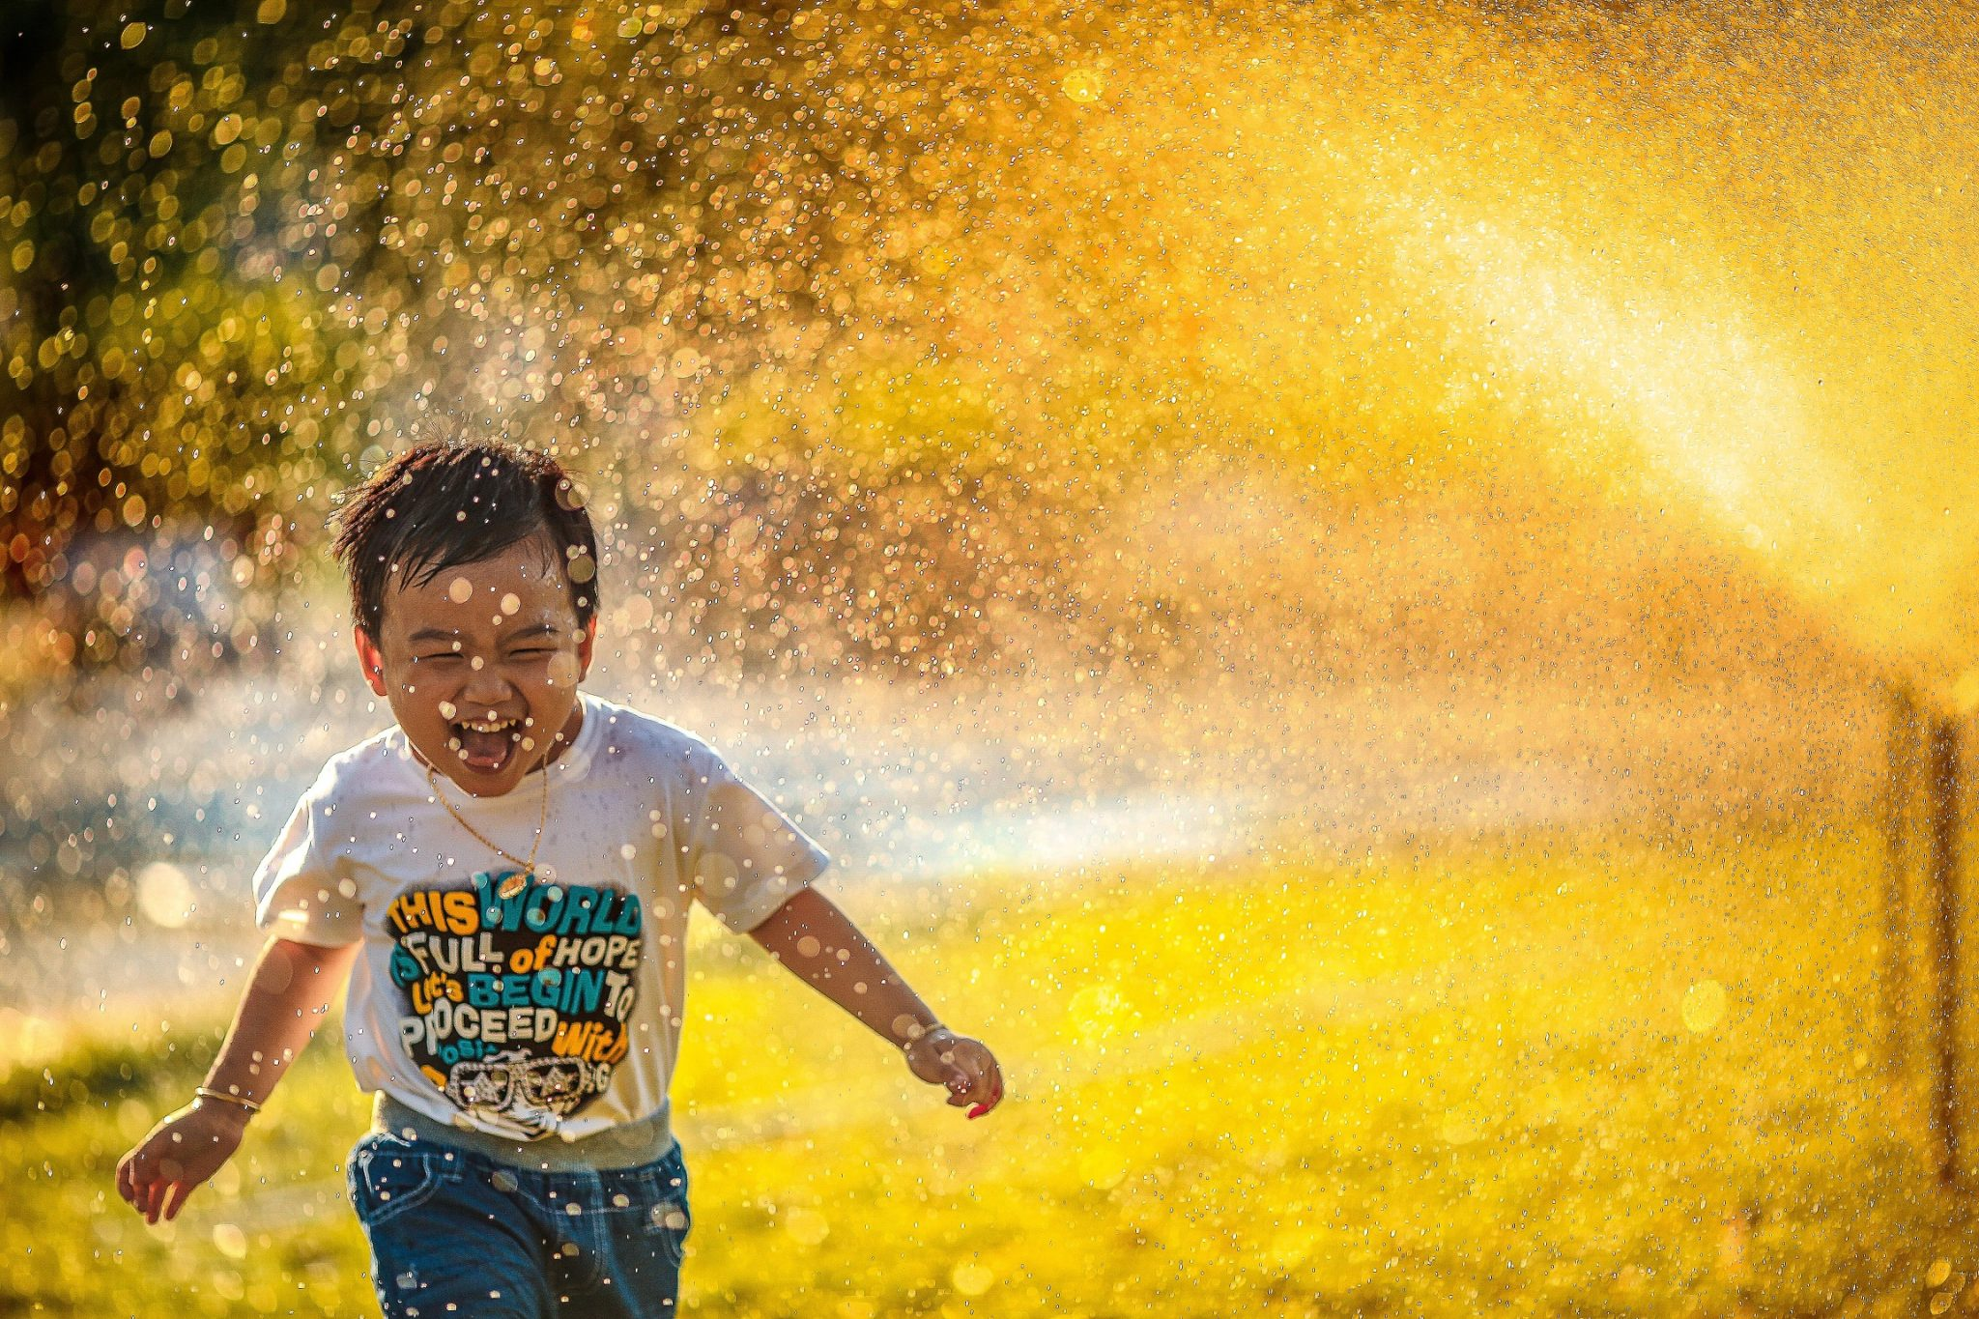
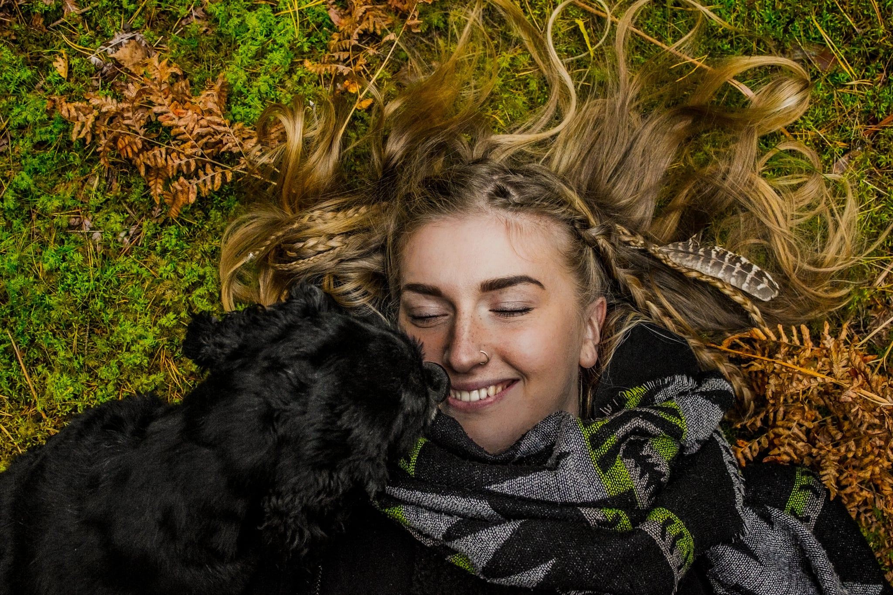

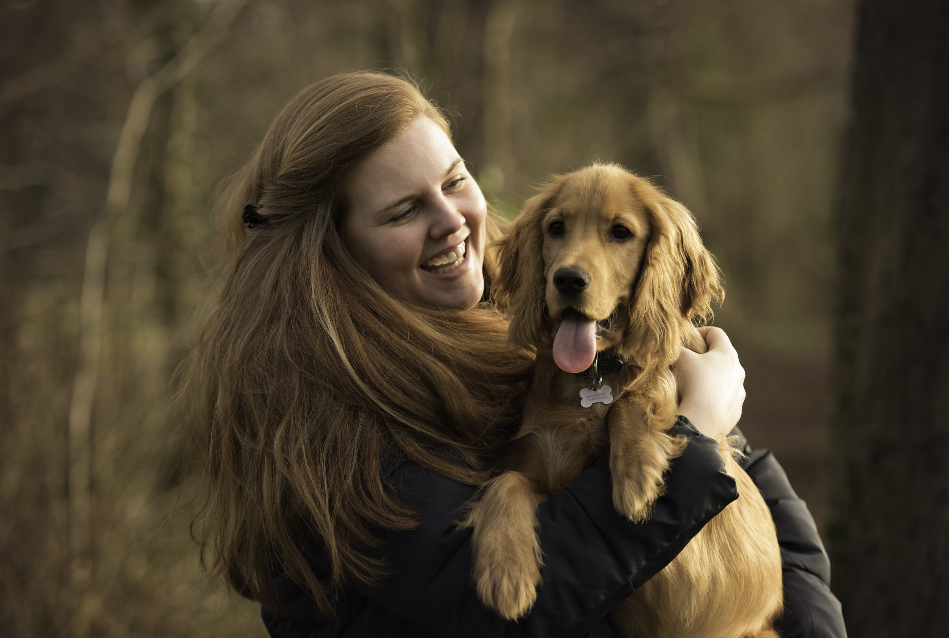
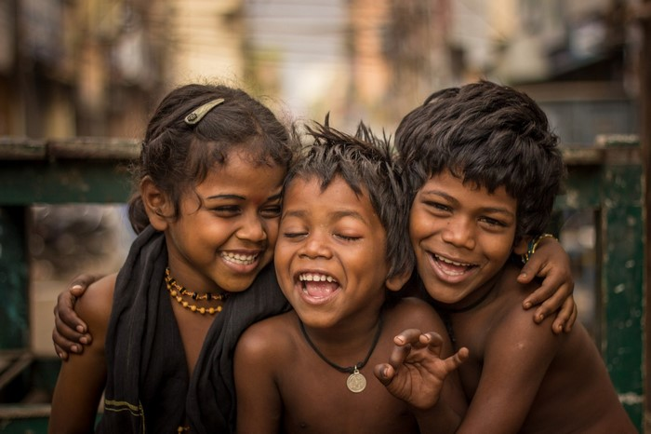
"Happiness is Quality Time”
"Happiness Is …" Photo Contest
MOBILE CONTEST
"Happiness is Dog Hug”
"Happiness is Kids smile”

Slide 32
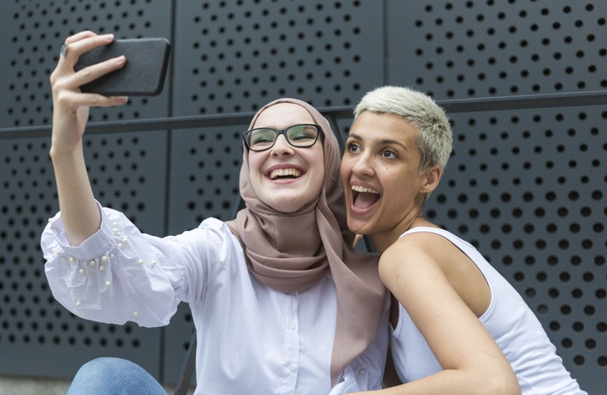
"Happiness Is …" Photo Contest
MOBILE CONTEST
USING YOUR MOBILE PHONE
We invites you to submit a photograph that best conveys what makes you happy, along with a "Happiness is …" caption.
(ex: "Happiness is watching Children laugh, Happiness is receiving a dog hug“.. etc..)

Slide 33

Thank You!

